Slide 1


Biology Presentation
FROM
CELLULASE
TO
DENIM
Krithika Vishwakarma, Div D-62

Slide 2


ABOUT CELLULASE
Cellulase is an enzyme that breaksdown cellulose into simpler sugars.
It is majorly found in plants and is absent in humans.
Cellulose breakdown is of great economic importance as it constitutes major part of plants available for consumption and chemical reactions.
It has a multi-enzyme structure with 3 constituent complexes and has been used by scientists for commerical production of glucose.

Slide 3
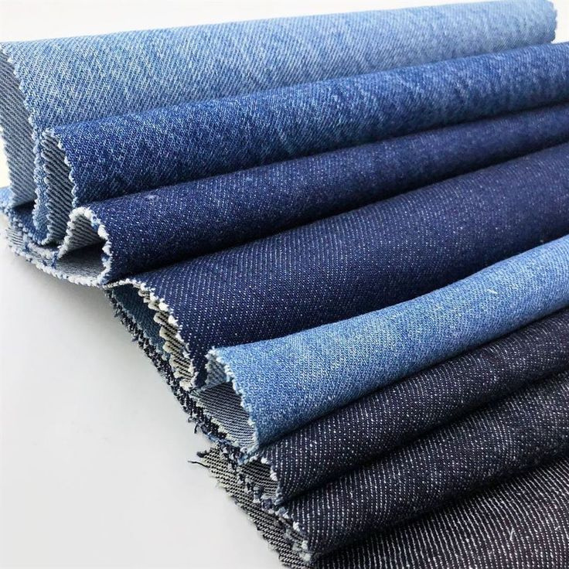

ENZYME WASHING
Also known as Bio Stoning is a textile manufacturing technique in which cellulase enzymes are applied to denim.
The intended effect is softer feel and faded appearance.
This technique originated in 1989 Europe and was followed by America the next year.
It became an alternative to stone washing which was practiced before enzyme washing emerged

Slide 4

PROCESS
In the enzyme wash process, cellulases act on exposed cellulose on the cotton fibers, freeing indigo dye from the fabric which gives the uniform faded look to denims. Longer the treatment, more is the fading effect. Cellulases are reactive for cellulose only so any impurities have to be removed prior to this process.
This method of producing denim fabric is better than stone washing which requires a lot of labour, time and is not eco friendly.
Cellulase is economical and can be recycled as well. Thus, enzyme washing is sustainable.
Neutral cellulases are applied at pH 6–7, while acid cellulases are applied at pH 4.5–5.5. Temperature as well increases with enzyme action but only within a certain range enzyme action is activated (50-60 degrees celcius)

Slide 5

ROLE AS A COMPUTER ENGINEER
Computer science and Fashion industry have collaborated in recent times with sustainable innovations and AI technologies in various fields within.
This is true also for the manufacturing industry wherein we see many techniques and machinery designed by computer engineers like the use of CAM or Computer aided manufacture that helps in fabric inspection, sewing, spreading, pressing.
These are essential steps in enzyme washing process and we can achieve optimal results with the help of such computerized methods. We can study enzyme reactions, catalysis and come up with methods to achieve results with sustainable usage of enzymes, best reaction times for large scale production.
Fabric Defect Checking Systems – Can be highly useful in checking fabrics for any defects which is an important condition for enzyme washing.

Slide 6



https://beyondtalentrecruitment.com/
https://textilelearner.net
REFERENCES
https://www.sciencedirect.com
https://textilelearner.net
wikipedia
Pinterest--> fashionsnoops.com
https://ebooks.inflibnet.ac.in/

